Slide 1
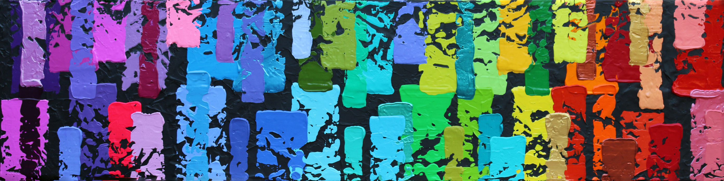

Foundation
Overview

Slide 2

OPTIMIST INTERNATIONAL FOUNDATION
Fellow Optimists…
this is
YOUR Foundation!
“Helping Optimists Help Kids”
Notes:
The Foundation exists to solely support Optimist International
By supporting the Foundation, you are also supporting Optimist International, its Members, and its Clubs
Our motto is “Helping Optimists Help Kids”
The Foundation provides support to Clubs as they undertake their mission in their community
Yes this is our Foundation!

Slide 3
VISION
We envision a Foundation that can provide significant funding for Optimist International’s youth and service programs and is proudly supported by individual Optimists, their Clubs, and the
community at large.

Slide 4
MISSION
Seeking, receiving and managing funds and real personal property for the benefit of Optimist International and
its Member Clubs for charitable, literary, and educational activities.

Slide 5
How Does OIF Support Optimist International?
Scholarships
World Oratorical Championship
Funding Youth Programs
Reel Optimism Video Contest
Notes:
OIF Budgets up to $10,000 per District for Oratorical, Essay and CCDHH scholarships.
OIF supports the World Oratorical Championship.
Provides Scholarships to the Regional Winners for U.S. and International Contestants
Provides the awards for Winning entries of the the Reel Optimism Video Contest
Supports youth programs including JOI

Slide 6
How Does OIF Support Optimist Clubs?
Club Fundraising
  Pass Through
  Club Campaign Fund
Club Grants
Notes:
Club Finance programs
The Foundation is a 501 (c)(3) Charitable organization
Gifts made through the Foundation are tax-deductible if used for a charitable, literary, or educational purpose
Club Pass through – for a fundraising program
If your Optimist Club is seeking grant funds or contributions for funding of your charitable community service projects or other charitable, literary, or educational programs, you may request the assistance of OIF as a 501(c)(3) charitable organization
Club Campaign Fund – Raising money for a specific Youth program
A way to assist Clubs in obtaining tax-deductible donations to support local projects and programs
Contributors can make tax deductible gifts to OIF designated for local Club projects and programs
Purpose of fund must be charitable and must support literary, educational or charitable programs of the Club.
Currently 3% simple interest
220 Accounts
Add approximately $45,000 in interest to Club Campaign accounts
Payout $300,000 Annually
Ongoing grant opportunities for Clubs to take advantage of annually. Information on each program is on the OIF Website.

Slide 7

CLUB MATCHING GRANT PROGRAM
Who is eligible
What projects are eligible
What is the time frame for projects
How can my club apply
What are the deadlines?
Notes:
Any Adult Club served by OIF is eligible to apply for a $1000 grant for a NEW project of the Club
Club Matching Fund Grant Application process opens on line on 1/6/21
Applications must have been received in St Louis by 3/15/2021
Winners notified by May 10, 2021
The project must start and finish between April 2021 and March 2022
Applications available at oifoundation.org January 2, 2018

Slide 8
CHILDHOOD HEALTH AND WELLNESS GRANTS
  Four Categories:
  Healthy Lifestyles
  Chronic Diseases
  Mental Health
  Disabilities
Notes:
Health and Wellness/CCC Matching Grant - $1000 grant for Childhood health and wellness
3 due dates for grant review
January 29, 2021
April 30, 2021
August 30, 2021
Childhood Health and Wellness Matching Grants – Launched in 2019 there will be $25,000 minimally available for grants. Four Focus Areas:
Healthy Lifestyles (Child Obesity, Healthy Eating, Physical Fitness, Happy Heart Advice, March of Dimes)
Chronic Diseases (Childhood Cancer, Juvenile Diabetes, HIV, Multiple Sclerosis, Muscular Dystrophy, Sickle Cell Anemia)
Mental Health (Depression, Bullying, Abuse)
Disabilities – Physical, Intellectual & Developmental (Autism, Special Olympics)
Applications and FAQ available on OIF website.

Slide 9

DISASTER RELIEF GRANTS
Major Natural Disasters, such as:
  Hurricanes
  Tornados
  Wildfires
  COVID 19
Notes:
Disaster Relief Grants – As needed grants around major Natural Disasters such as Hurricanes, Tornados, Wildfires or others. Hurricane Katrina - specific, Launched Disaster Relief in 2018
Disaster Relief Grant – Up to $1000 grant for clubs to work in their communities after a natural disaster.
These applications may be accessed from Optimist International Executive Director Benny Ellerbe or from Optimist International Foundation’s Executive Director Craig Boring. Applications will be processed immediately.

Slide 10
50 Years of Helping Optimists Help Kids!
Notes:
The OIF was chartered on February 18, 1971
Celebrating 50 years in 2021!

Slide 11
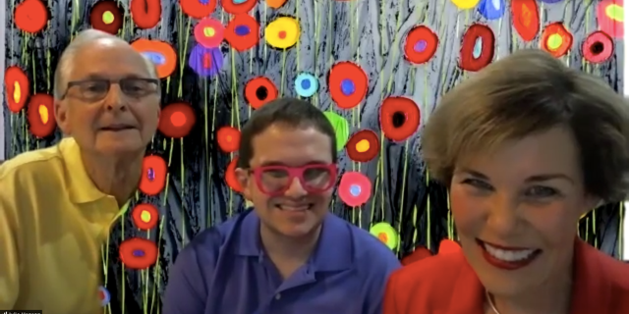
PARTNERSHIP WITH ARTIST JEFF HANSON
Notes:
Hal, Jeff and Julie Hanson
Hanson art to partner with us for our 50th anniversary
Many of you may have met the Hansons at our Centennial Convention in Louisville
Their story is inspiring, Jeff’s art is beautiful
Their optimistic and giving spirt is exemplified in Jeff’s words, “Every act of kindness help create kinder communities, more compassionate nations and a better world for all…even one paining at a time”
The partnership with the Hansons helped pull the 50th theme together

Slide 12
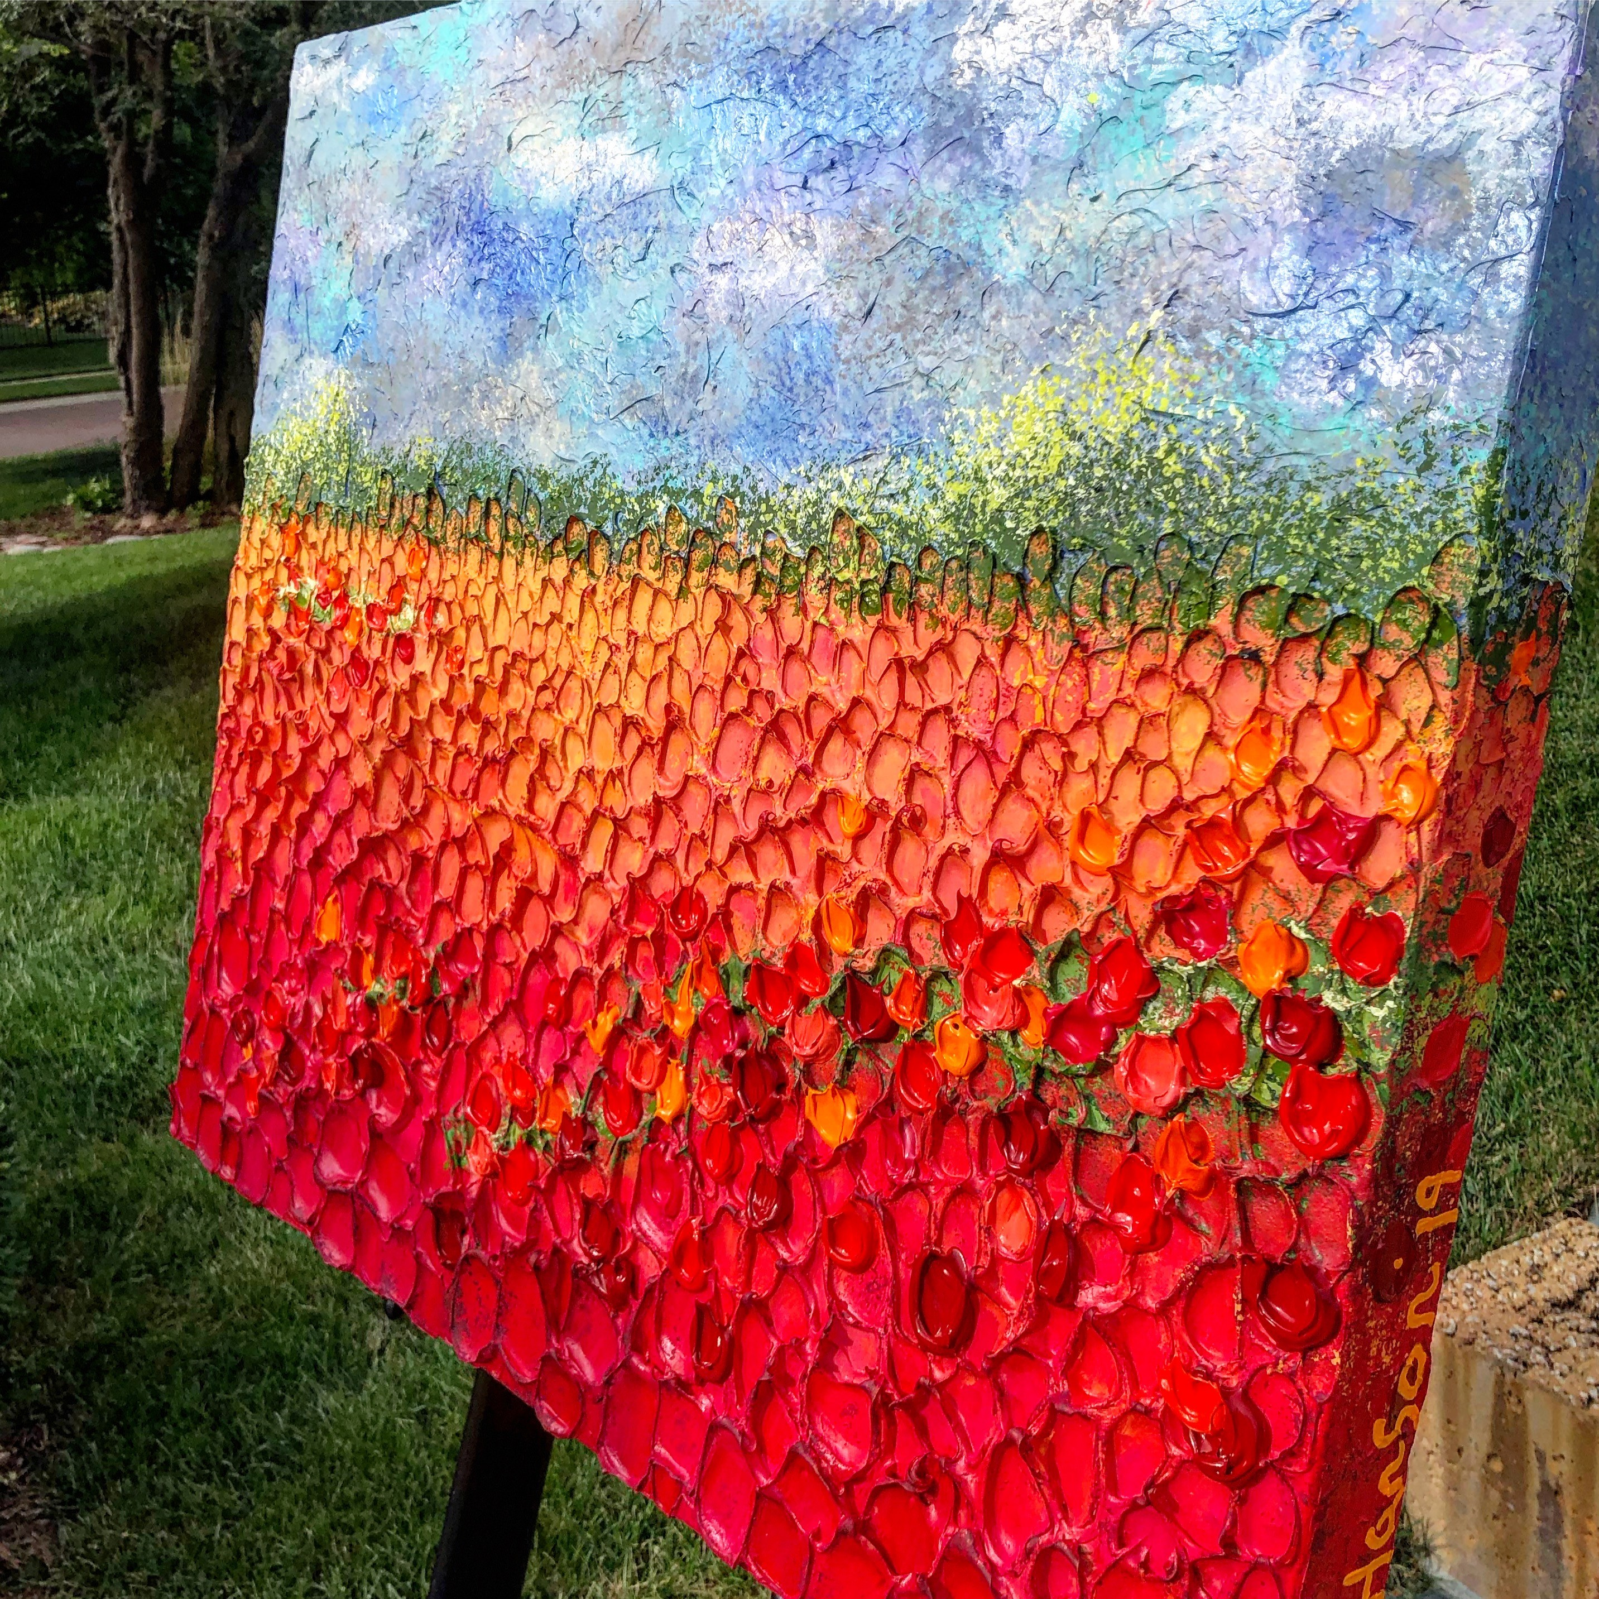
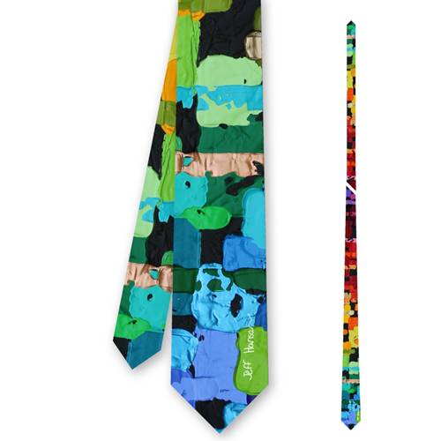
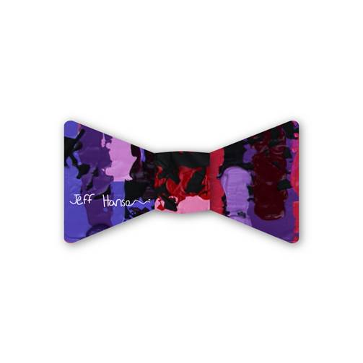
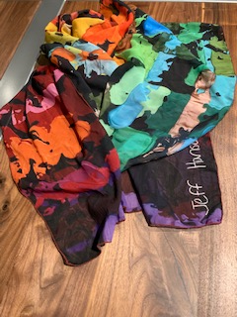
SPECIAL FUNDRAISING EFFORTS
ON-LINE AUCTION
HANSON SCARF, TIE, BOWTIE
HANSON NOTECARDS
Notes:
Starting with Special 50th Anniversary Fundraisers
Art work for auction – “Only in Holland”
Many other items and packages
On line Auction will run February 11 – March 11
Hoping Districts and members will donate items
Will be on website, with links through social media
Special Hanson Items, net proceeds will support Childhood Health and Wellness
Tie, Bowtie, Scarf at $50 each
Special OIF 50th Hanson Notecard set
$20 for a set of 6
These items will be on line
Share on social media #JeffHansonArt

Slide 13
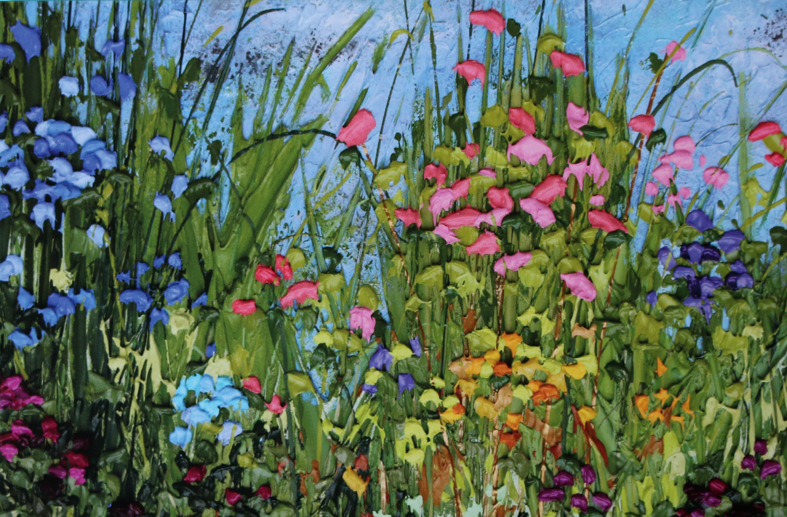
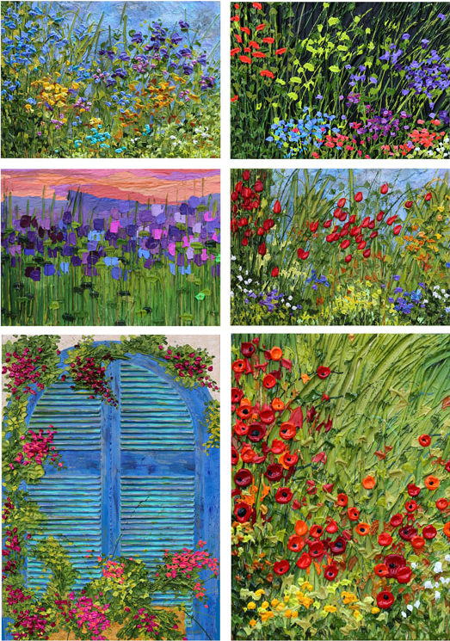
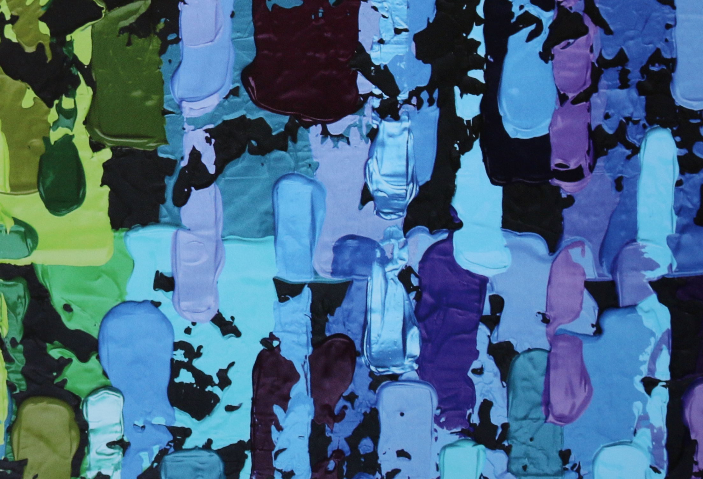

Slide 14
FUNDRAISING PROGRAMS
How Does OIF Fund Ongoing Projects?
Member Donations
Club Donations
Endowments and Sponsorships
Investment Resources
Notes:
Member and Club donations are the backbone of generating Foundation revenue generation.

Slide 15
PROGRAMS FOR CLUBS
Dollar A Day
Friend of Today
Recognize a Member
  In Honor-In Memory Patch
  Christian Larson Partner
Annual Per Member Giving Club Patch
Notes:
Talk about these in a bit more detail

Slide 16
CLUB 365 PATCH
Notes:
When a Club donates $365 unrestricted, or $1 a day during the Optimist year, they will receive a Club banner patch.
Clubs donating $500 will also receive a Friends of Today plaque and a certificate.

Slide 17
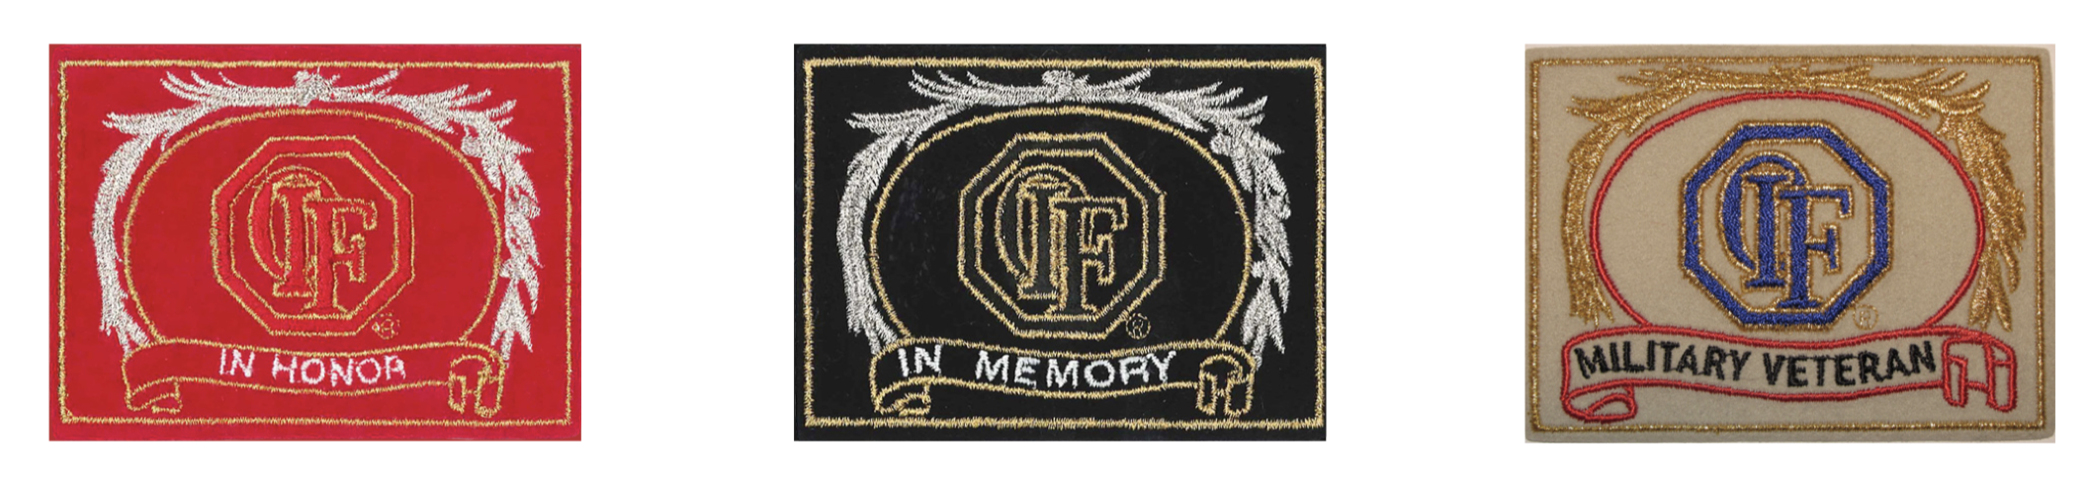
IN HONOR-IN MEMORY PATCH
Notes:
A great way to recognize an individual that has served their Club and Community
$100(unrestricted) per Name Bar for banner

Slide 18
PROGRAMS FOR INDIVIDUALS
Dime-A-Day ($50 for 2020-2021)
Presidents Club
Friends of Today
Christian D. Larson
Friends of Tomorrow
William H. Harrison Society
Women's Philanthropy Council
Notes:
Talk about these in a bit more detail

Slide 19
DIME A DAY – SPECIAL 50TH PIN
Notes:
The Dime-A-Day pin will be replaced with this special OIF 50th Anniversary pin. It can be earned by contributing $50 to the OI Foundation within the 2020-21 Optimist Year.
This level of giving is an opportunity for all Optimists to support their Foundation and receive this beautiful commemorative pin.
Many DFRs will hold a completion between Clubs to see which Club can reach the highest percentage of members contributing at this level

Slide 20
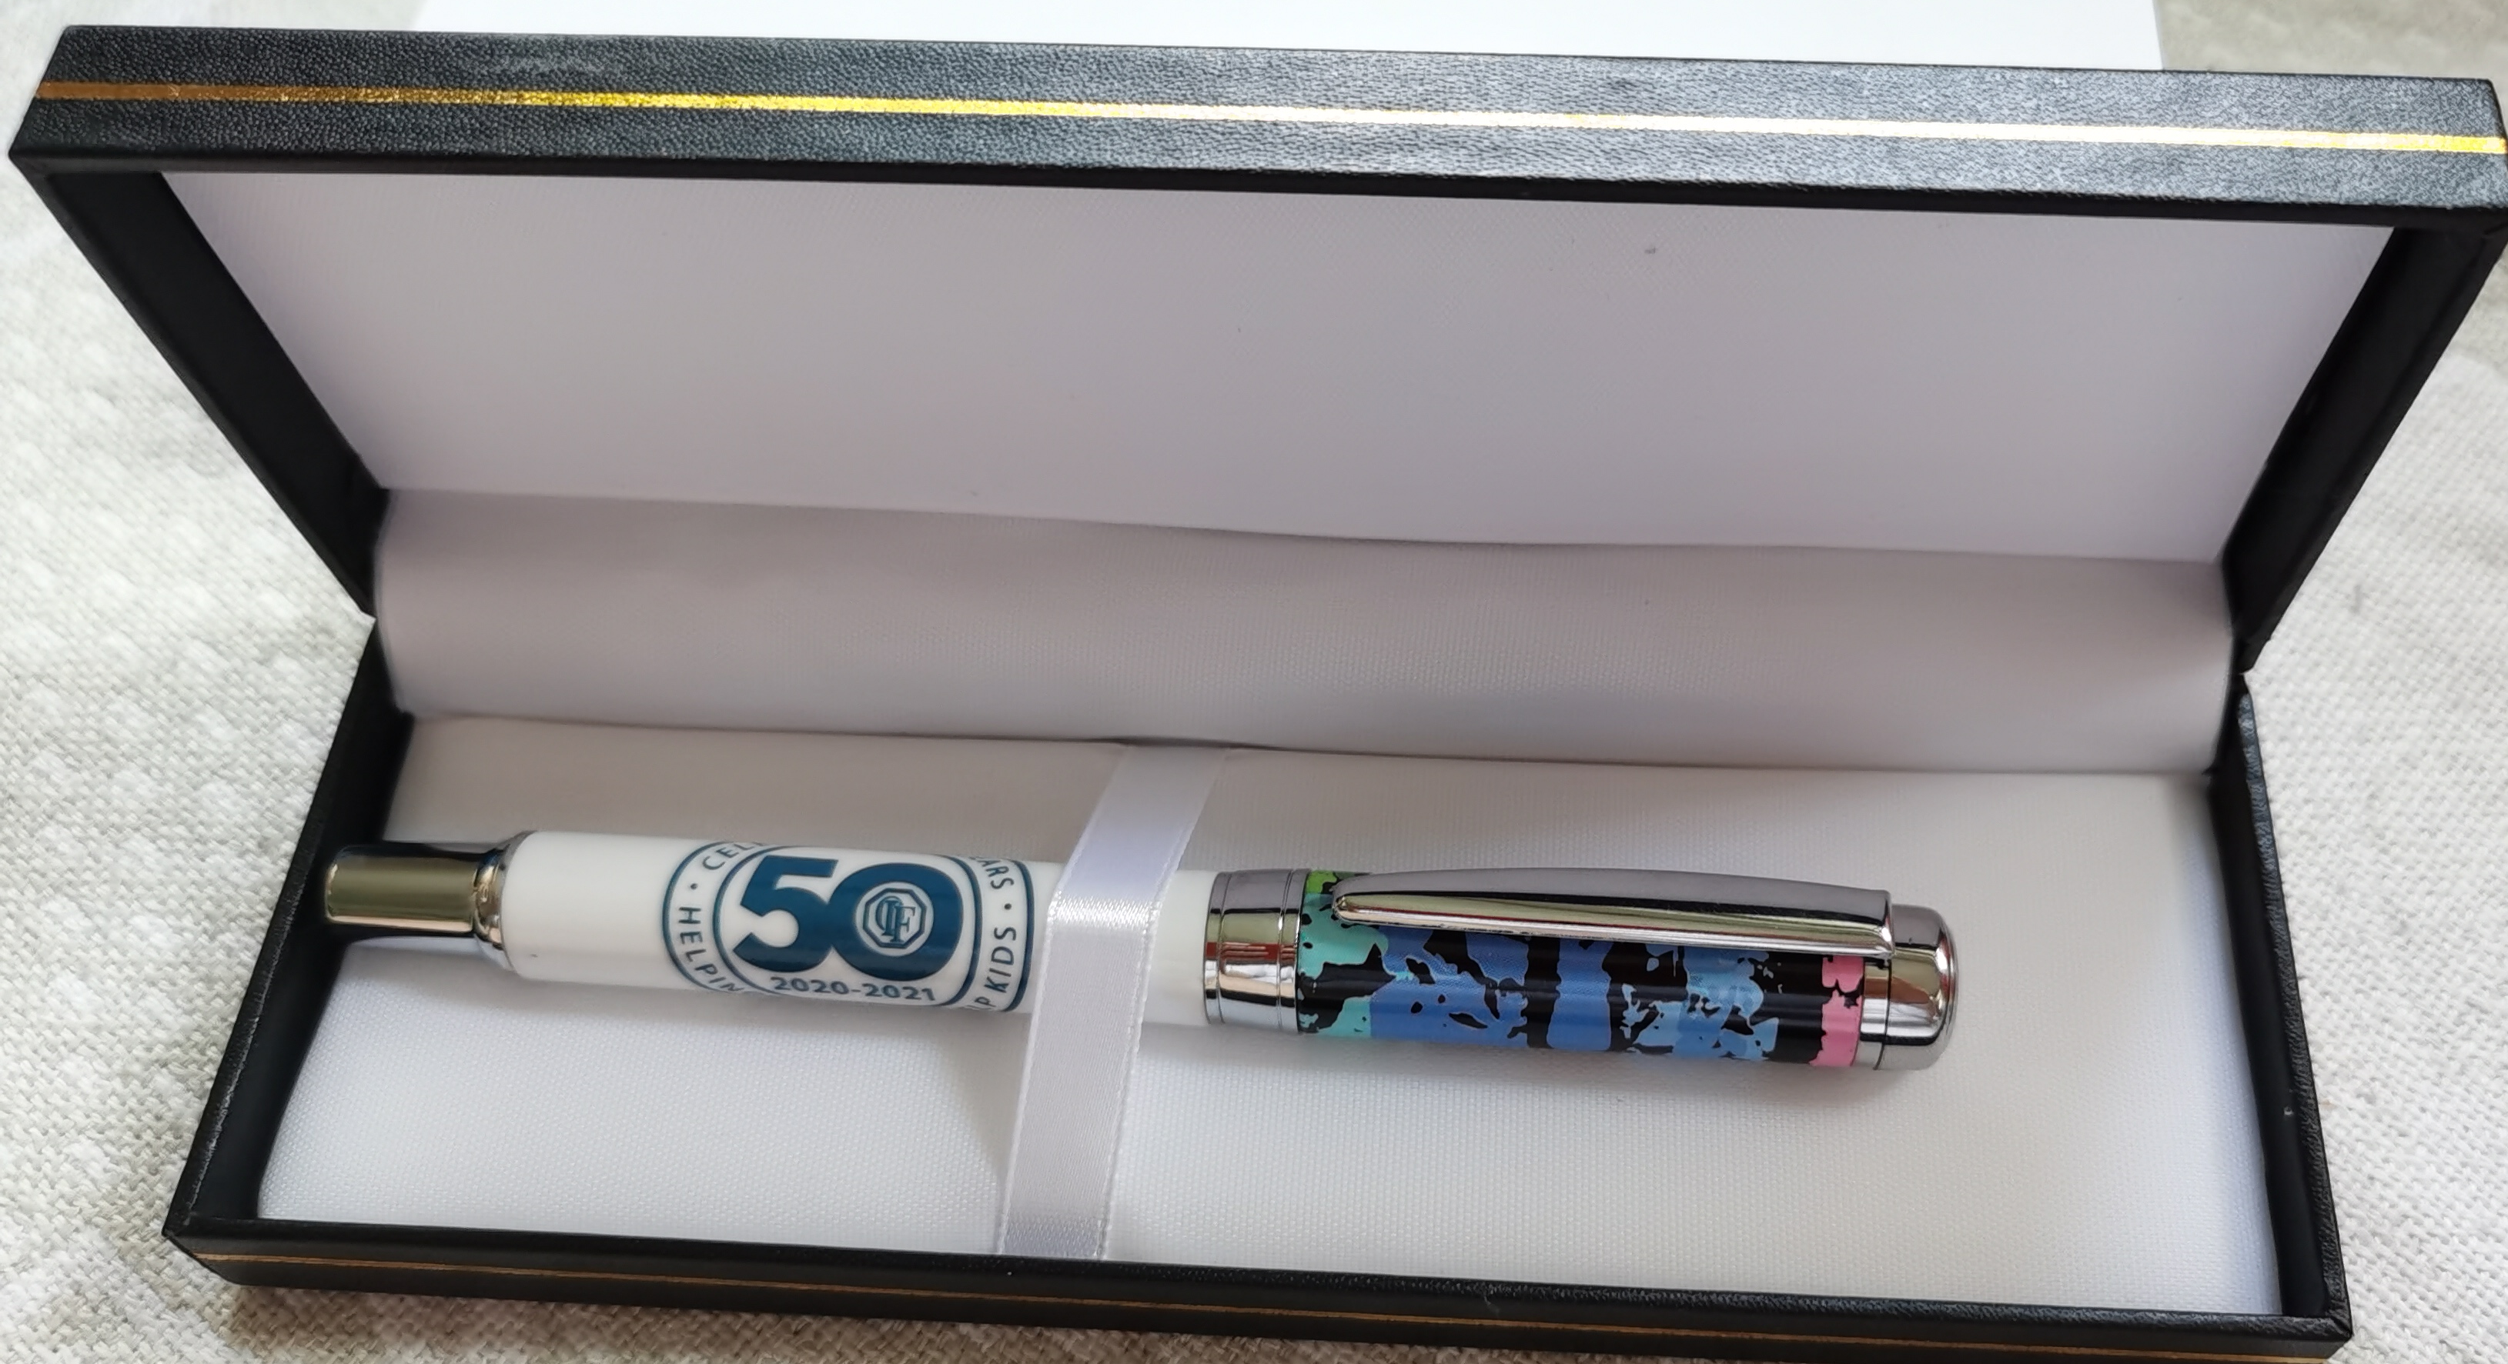
PRESIDENT’S CLUB PEN
“Helping Optimists Help Kids”
Notes:
Become a member of the Presidents Club by making an initial unrestricted gift of $250, and renew your membership each year by making an annual $250 contribution.
When you join, you will receive the prestigious Presidents Club lapel pin. The President’s Club member will receive a pen inscribed with the year and theme.
Each year at Convention, you will be recognized with a ribbon for your badge and will be invited to attend a function exclusively for members of the Presidents Club

Slide 21
FRIENDS OF TODAY
“Helping Optimists Help Kids”
Notes:
A Friend of Today makes a minimum unrestricted donation of $500 annually to the Foundation and receives the year’s theme print embossed on a metal plate mounted on a plaque.

Slide 22
WOMEN’S PHILANTHROPY COUNCIL (WPC)
Notes:
Women’s Philanthropy Council
The Women’s Philanthropy Council was formed to support the work of the Optimist International Foundation.
Members reach out to women as donors and help shape their philanthropy
The giving circle of WPC begins with an annual gift of at least $100 and is recognized with a limited edition pink purse pin

Slide 23

Honoring the author of our
“Optimist Creed”
Awarded to donors of $1,000 unrestricted dollars
within one Optimist year.
Notes:
One of the highest honors we can give to a generous supporter of the Foundation is the honor of becoming part of an exclusive group of donors known as the Christian D. Larson Partners. Named after the author of ‘The Optimist Creed’, this giving level was adopted to recognize donors who contribute $1,000 unrestricted within one Optimist year.
Participants who become members of the Christian D. Larson Partners join an elite group of individuals dedicated to following the Creed, and to helping fund the Foundation’s mission through their personal giving.
Christian Larson

Slide 24
WILLIAM HARRISON SOCIETY
William H. Harrison,
The first President of
Optimist International, 1919-1920
Notes:
The Optimist International Foundations introduced the William H. Harrison Society in 2001.
The organization is named after the first Optimist International President, William H. Harrison, whose drive and determination helped propel Optimist International into a premier service organization.
The Foundations’ Board of Directors created this Society as a special way to recognize the Major Donors of the Foundation.
To become a Member of this Society, life-to-date giving to the Optimist International Foundations must be $10,000 or more. Annual contributions of $1,000 are required to maintain Membership in the Society.

Slide 25


Benefactor Lifetime Recognition Levels
:
Benefactor $1,000
Honored Benefactor $2,500
Distinguished Benefactor $5,000
Eminent Benefactor $10,000
Bronze Benefactor $15,000
Silver Benefactor $25,000
:
Golden Benefactor $50,000
Diamond Benefactor $75,000
Copper Benefactor $100,000
Pearl Benefactor $250,000
Sterling Benefactor $500,000
Platinum Benefactor $1,000,000
Notes:
Benefactors are recognized with a bar pin as they reach cumulative levels of giving:
Lifetime Recognition Levels
AMOUNT
RECOGNITION LEVEL
PIN
Benefactor
$1,000
Gold, no stone
Honored Benefactor
$2,500
Gold, Amethyst
Distinguished Benefactor
$5,000
Gold, Aquamarine
Eminent Benefactor
$10,000
Gold, Blue Sapphire
Bronze Benefactor
$15,000
Gold, Yellow Topaz
Silver Benefactor
$25,000
Gold, Ruby
Golden Benefactor
$50,000
Gold, Emerald
Diamond Benefactor
$75,000
Gold, Diamond
Copper Benefactor
$100,000
Silver, One Diamond
Pearl Benefactor
$250,000
Silver, Two Diamonds
Sterling Benefactor
$500,000
Silver, Three Diamonds
Platinum Benefactor
$1,000,000
Silver, Four Diamonds
Recognize these donors with appropriate congratulations at our District meeting anr newsletter.

Slide 26
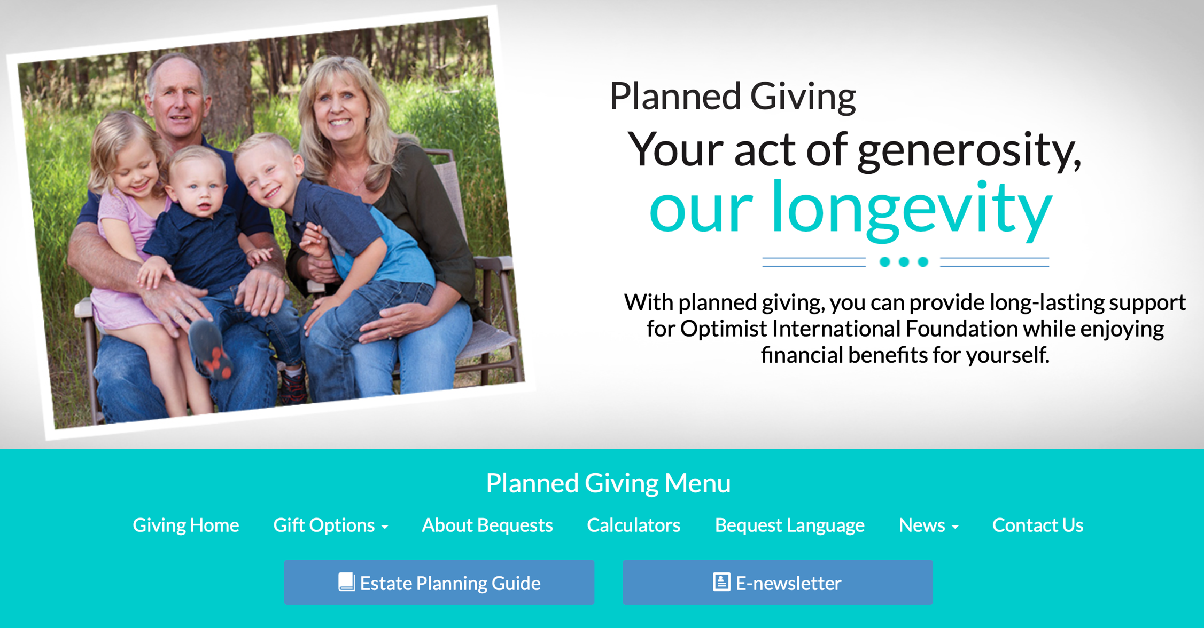
FRIENDS OF TOMORROW
Notes:
Friends of tomorrow
Recognizes those that have arranged a charitable bequest to OIF.
A bequest provides for the future needs of OI programs and OIF.

Slide 27
THE ROLE OF A CLUB FOUNDATION REPRESENTATIVE
  Communication
  Contributions
  Send Contributions to OIF
Notes:
Very important for Clubs to have a CFR
They can help raise funds for our Foundation
They can help keep Club members informed of benefits and grants available from OIF

Slide 28
HOW TO APPOINT A CFR
Appointed by the Club President
CFR will serve until replaced
Appointment forms can be found online at www.oifoundation.org
Notes:
It is a requirement for Clubs to receive Honor or Distinguished status to have appointed a CFR and make a contribution of $100 or more to our Foundation

Slide 29
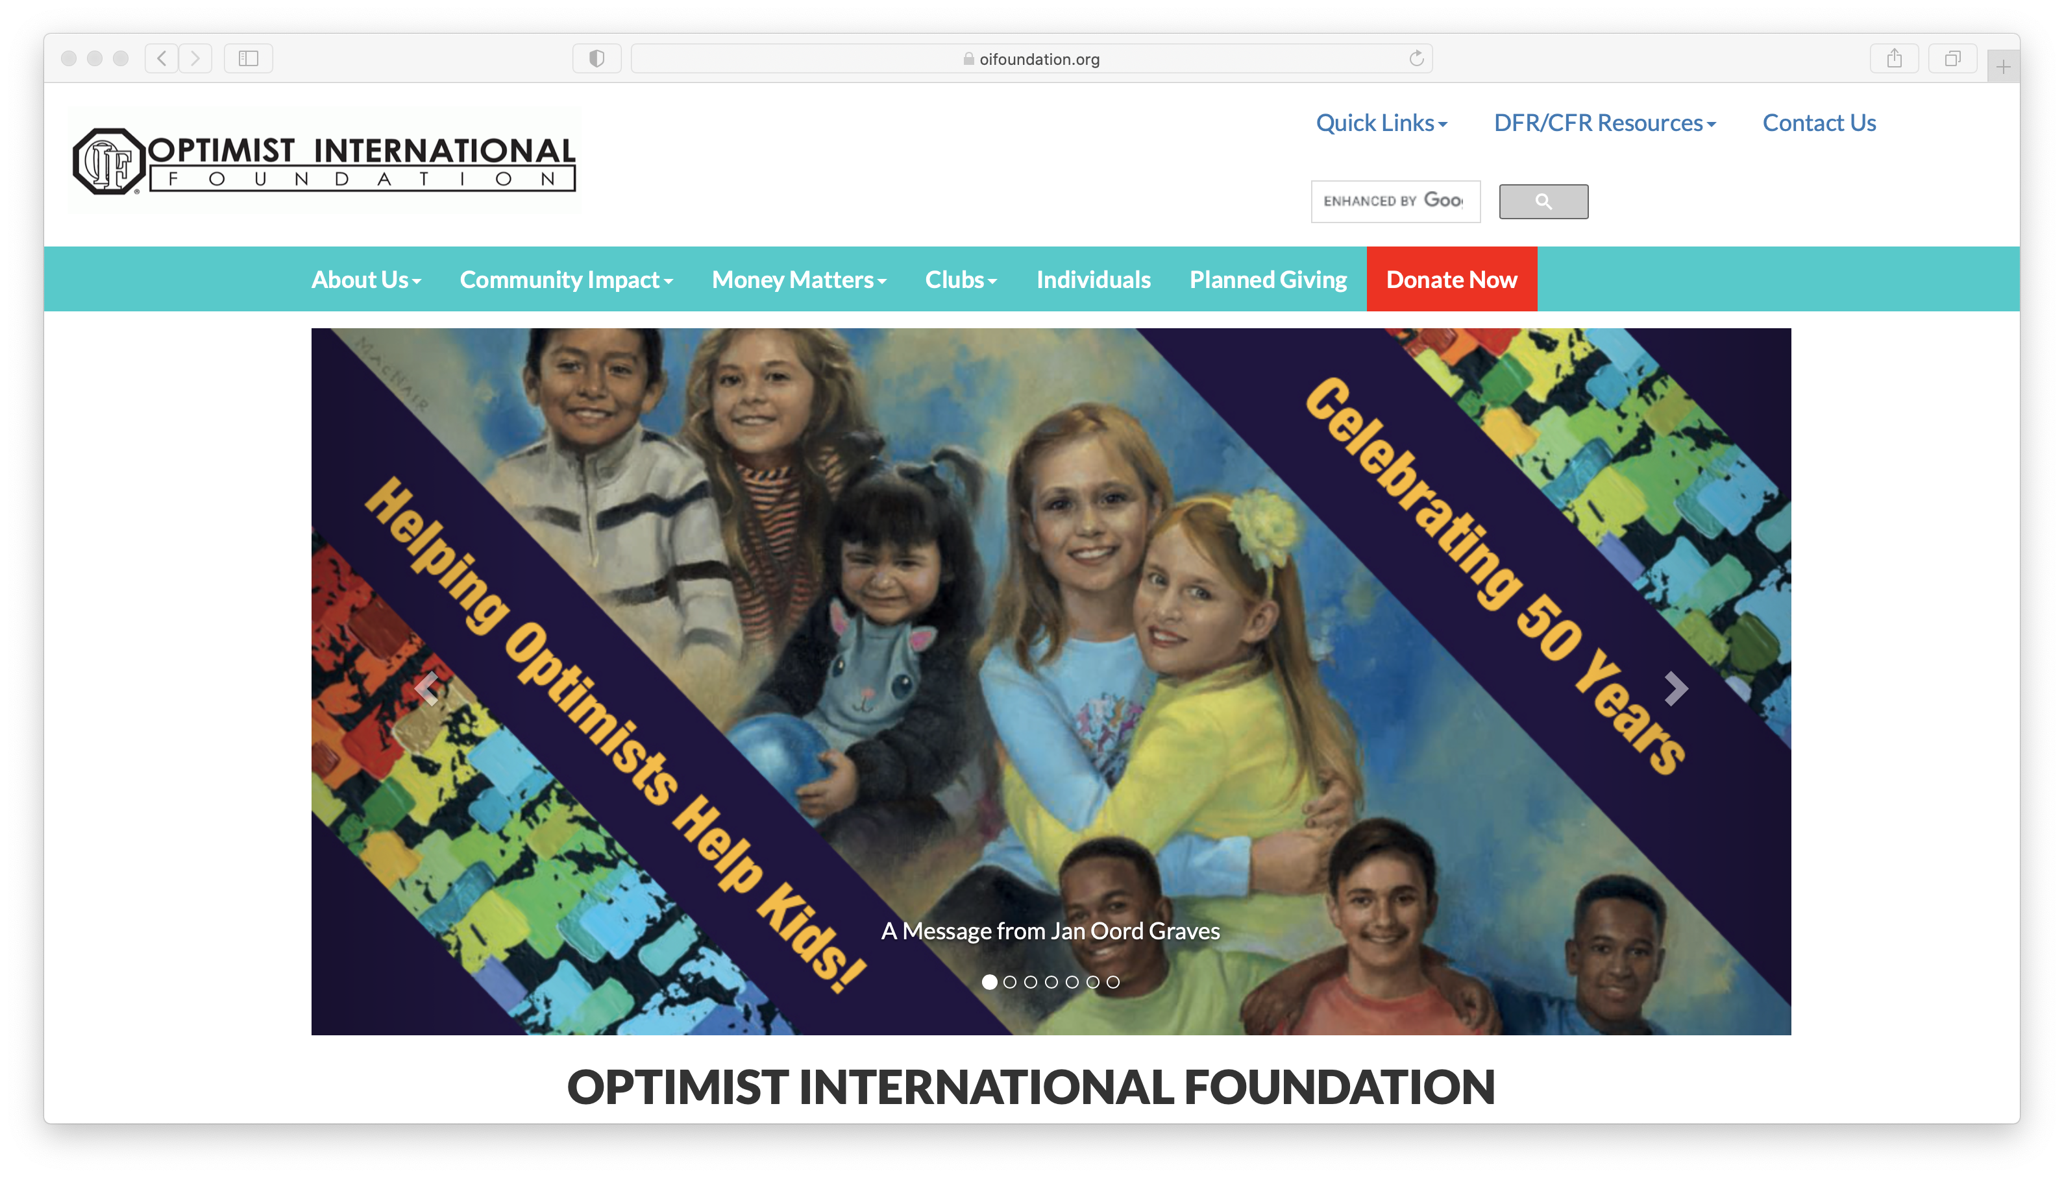
          www.oifoundation.org
          800.500.8130 Ext 203 info@oifoundation.org
WHERE CAN WE GET OIF INFORMATION?
Notes:
The website contains:
Information about the Foundation and financials
Information about upcoming programs
Forms for giving and information about those giving programs
Latest news from OIF
For more information, please contact the Foundation office:
Or contact your local District Foundation Representative

Slide 31
2020-2021 OIF LEADERSHIP
OIF Board of Directors
  Janet Oord Graves, President
  Marc Katz, President Elect
  TG Thomas,Treasurer
  Teri Davis, Board Member
  Jim Kondrasuk, Board Member and Past OI President
OIF staff:
  Craig Boring, Executive Director
  Shenita Taylor, Senior Director, Donor Services
  Patti Ashby, Donor Services Coordinator
  Zoe Williams, Admin Assistant
Notes:
OIF Board of Directors are OI members who have served as District Foundation Rep and believe in the mission and vision of OIF.
OIF Board of Directors: OIF is led by a Board of directors that is elected by OI members.
Each March, a new member is Elected to serve a 4-Year Term

Slide 32
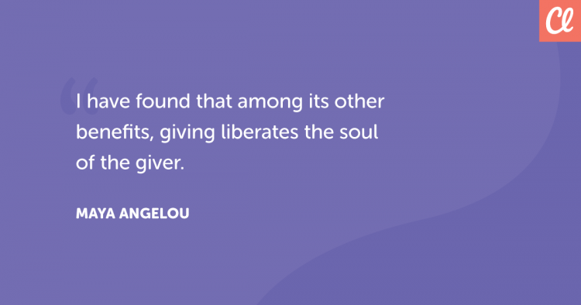
Notes:
You may be aware that about 8% of our members and 24% of our Clubs contribute annually to our Foundation
Would like to see these numbers increase
Give every Optimist the satisfying feeling of having supported the many youth projects, scholarships and grants that our Foundation funds
Of course we are all able to give at different levels, but if each of us does what we can, what an impact we will have!

Slide 33
Thank You, Gracias, Merci, Danke to each of you and your Clubs for supporting our Foundation and our Youth!
Jan Oord Graves
oordj@yahoo.com
(269) 873-1954

